Slide 1
Project 1
Detailed explanation of the code

Slide 2

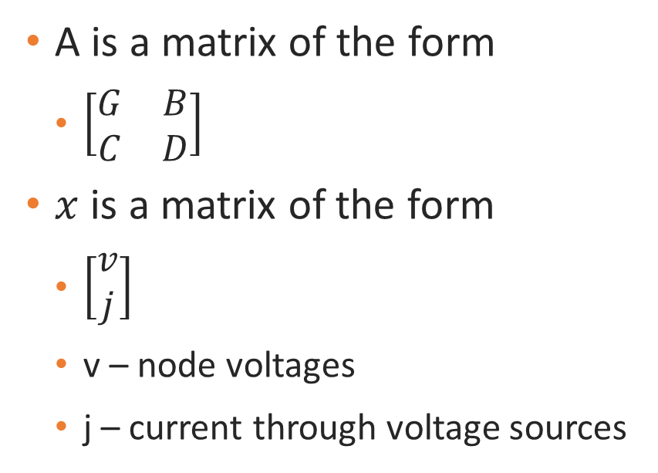
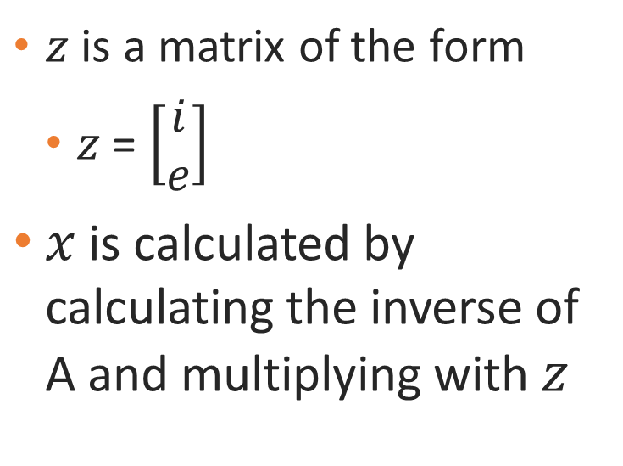
Modified nodal analysis
$$Ax=z$$
A is a matrix of the form
$\left[\begin{matrix}G & B \\ C & D\end{matrix}\right]$
$x$ is a matrix of the form
$\left[\begin{matrix}v \\ j\end{matrix}\right]$
v – node voltages
j – current through voltage sources
$z$ is a matrix of the form
$z$ = $\left[\begin{matrix}i \\ e\end{matrix}\right]$
$x$ is calculated by calculating the inverse of A and multiplying with $z$

Slide 3
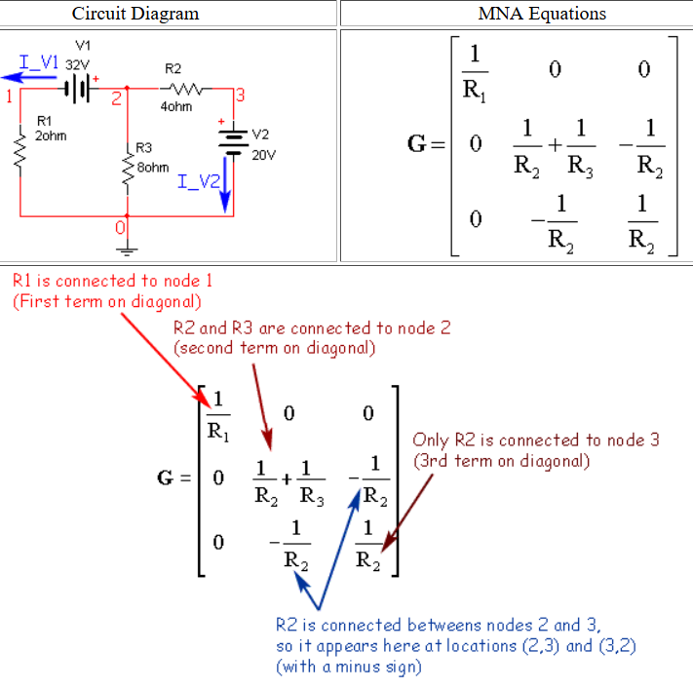
Modified nodal analysis
G is the conductance matrix created through circuit structure
G(i,i) is sum of the conductance of each element connected to the corresponding node
G(i,j) is negative conductance of the branches connected to the pair of corresponding nodes i and j.

Slide 4
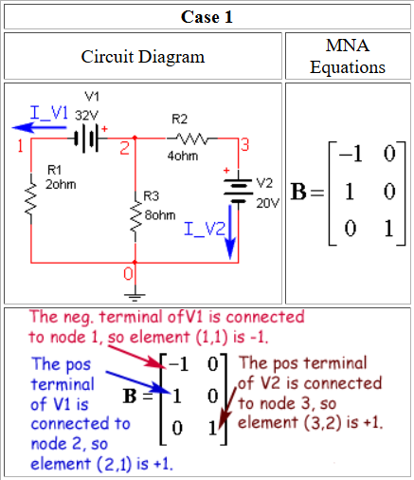
Modified nodal analysis
B is the matrix constructed with -1, 0 and 1, describing the connections of its two terminals to nodes
C is the transpose of B
D (in the code, it is z0) is the zero matrix when dealing with independent sources

Slide 5
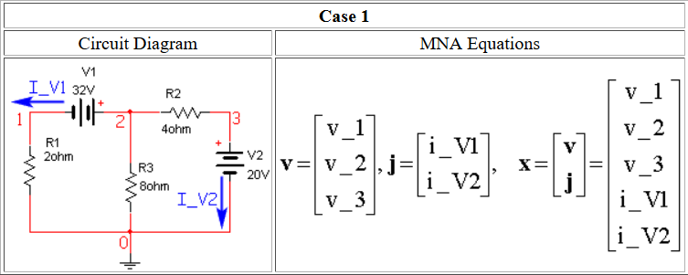

Modified nodal analysis
Matrix $x$ holds the unknown quantities
It is the combination of v and j column matrices
Matrix v is the column vector of all nodal voltages (except reference)
Matrix j is the column vector of all currents through voltage sources

Slide 6
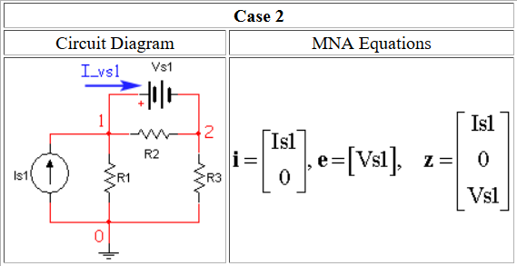
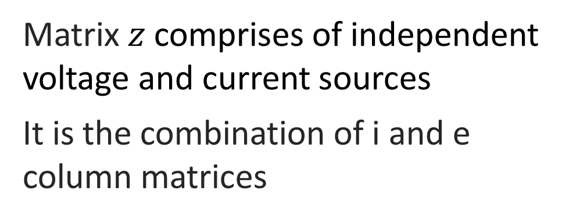
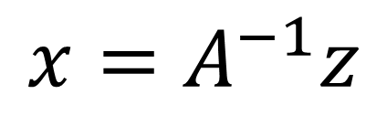
Modified nodal analysis
Matrix $z$ comprises of independent voltage and current sources
It is the combination of i and e column matrices
Matrix i is the column vector containing the sum of independent current source currents into each node
Matrix e is the column vector consisting of all values of voltage sources
$$x=A^{−1}z$$

